Slide 1
Data Analyst Project -Retain first attempt ELCHAI REFOUA
TLV, Israel

Slide 2


Table of contents
01
My work process
Insights and conclusions
02
Tools I used
03
04
Challenges I faced and how I solved them
05
06
What would be your next steps
The reasoning behind the analysis I chose to do
07
Any other information you find relevant

Slide 3
01
My work process
Overview of the work process in Python

Slide 4
My work process:
Testing and analyzing data by variable type and selecting characteristics for
Loading the data, getting general information and finding directions for analysis and investigation
Analysis & visualizations
conclusions
import & info
continiouse
01
02
03
04
05
Categorical
further investigation &Statistical tests
split
splitting the testing and analyzing of the data according to: continuous and categorical variables
Further investigation of the selected variables

Slide 5
02
Tools I used

Slide 6
Tools I used
Pandas: Essential for data manipulation and analysis. Used for importing, cleaning, and transforming the dataset.
NumPy: Enables efficient numerical computations. Employed for handling multidimensional arrays.
Matplotlib: Fundamental for visual data exploration. Used to generate histograms, boxplots, scatter plots, and bar charts.
Seaborn: Enhances data visualization. Deployed for creating advanced statistical graphics like violin plots and count plots.
Correlation Analysis: Statistical tool for understanding relationships between variables. Used to analyze the interdependence of numerical variables.
Null Values Handling: Technique for ensuring data integrity. Utilized for managing missing data, either by dropping or replacing them.
Lambda Functions and Apply: Streamlines data transformations. Used to apply functions to data efficiently across rows or columns in Pandas.
GroupBy and Aggregation: Powerful for summarizing data. Used to segment the dataset into groups and apply summary statistics
Scipy.stats: Scipy is a scientific computation library that builds on NumPy. The 'stats' module in Scipy contains statistical functions including statistical tests like the chi-square test used in this analysis.

Slide 7
03
The reasoning behind the analysis I chose to do

Slide 8
The reasoning behind the analysis I chose to do
My chosen strategy for this analysis was to identify the key factors influencing the success rate of subscription payments on the first attempt. Utilizing data analysis techniques, I examined the relationship between various features and transaction success rates.
This included dividing the data by variable types and conducting statistical tests to gain valuable insights.
My aim was to minimize reduce subscription cancellations caused by payment failures and boost the efficiency of Retain's payment recovery solution. This approach allowed me to expose pivotal elements that could potentially improve the transaction success rate on the first attempt.
'current_disposition_labelled’

Slide 9
04
Challenges I faced and how I solved them

Slide 10
Challenges I faced and how I solved them
Varied Characters in Data: Encountered a wide variety of characters in variables which complicated the data exploration. Solution: Changed the approach to data exploration, starting from a small subset and gradually expanding to include more data for more effective investigation.
Limited Time Frame: The challenge was managing the time constraints with personal commitments like a Jewish fasting period and professional work. Solution: Prioritized and focused on core elements of the analysis, and maintained a steady pace of work.
Initial Document Issues: There were problems with the documents initially provided for the analysis. Solution: Resolved the issues through clear and polite communication, thus ensuring a firm basis for further analysis.
Null Value Treatment: The decision on how to handle null values was a significant challenge due to company policy considerations. Solution: Exercised discretion in handling null values based on context and the impact on the analysis.
Variable Classification: Classifying variables into continuous and categorical types was challenging due to their diverse nature. Solution: Classified variables based on their relationship with the main variable, aiding in better understanding of their roles in the analysis.
Unexpected Analysis Paths: Some unexpected findings in the data led to deviations from the initial analysis plan. Solution: Remained adaptable and readily shifted focus in the analysis based on new insights, thus maintaining the quality of the analysis.

Slide 11
05
Insights and conclusions

Slide 12
variable being tested:
The focus of this study is on the variable
'current_disposition_labelled’
We will be Analyzing Factors Impacting 'Current Disposition Labeled'
We're studying the 'current_disposition_labelled' variable. It marks if a transaction worked on the first try. '1' means it did, '0' means it didn’t.
Our script checks what influences this variable. It finds out how much they relate, how often they happen, and their total amounts.
The aim is to help more transactions succeed the first time. This way, customers are happier and the company can improve its operational efficiency and financial performance

Slide 13
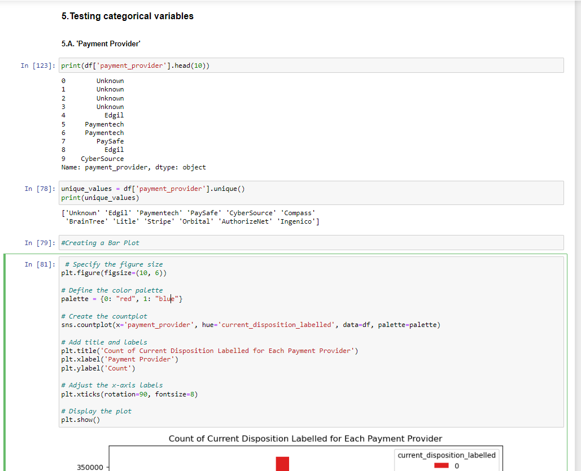
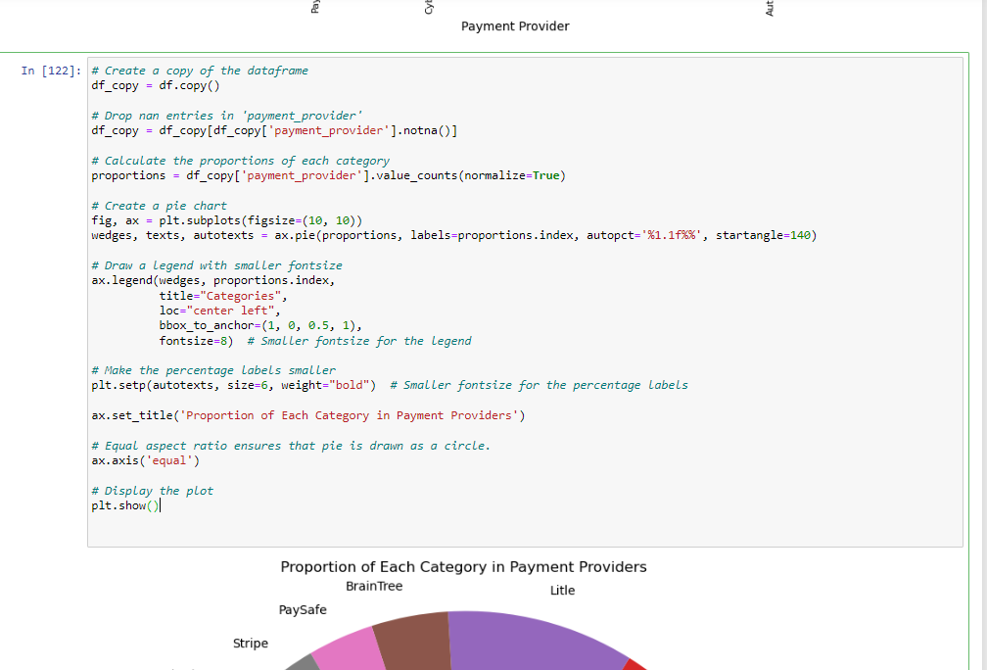
An example of a Python script - from the Gopiter notebook
*payment provider

Slide 14
Identified Variables: Categorical Factors We will present the top 3 from each category : left is the highest
important point: The number rows in the DataFrame is 1,048,575
explanation | comments | Percent- Of all | Count OF ‘O’ | top 3 categories | Field
payment provider | Compass is the most influential category variable .But he is also the most common | 35.5%, 19.4%, 11/4% | 350K+, 200K-, 100K+ | Compass, Edgil, Paymentech | 'Payment Provider’'
method of payment like credit card, debit card, etc. | - | - | non | non | 'payment_method_id'
credit card or debit cards | Credit is the most influential category variable by a relatively small margin | 47%, 45%, 0.001% | 450k, 400k+ | Credit , debit, charged | ‘credit_card_type’
Bank Identification Number | 414720 is the most influential category variable | 4.7% 1.5% 1.4% | - | 414720, 440066, 426684 | credit_card_bin

Slide 15
explanation | comments | Percent- Of all | Count OF ‘O’ | top 3 categories | Field
brand of credit card such as visa, master, etc | USE MORE, BUT MORE ‘O’ | Visa 63.7% MASTERCAR 28.6% WELLS F. BANK 5.1% | 600K- 300K- 5K- | VISA, MASTERCAR, AMERICAN X | credit_card_brand
the bank of issuing the credit card | USE MORE, BUT MORE ‘O’ | CHASE BANK 11.4% B. O. AMERICA 7% WELLS F. BANK 5.1% | 100k+ 60k+ 40k+ | CHASE BANK, B. O. AMERICA, WELLS F. BANK | 'credit_card_issuing_bank'
country of the bank that issued the credit card | USE MORE, BUT MORE ‘O’ | 91.1% 2.9% 2.6% | 800K+ 2.5K- 1K+ | U.S.A U. KINGDOM CANADA | credit_card_issuing_bank_country
code of currency based on each country | “ | 96% 2.8% 0.5% | usd | USD GBP EUR | 'currency_alphabetic_code'
country of the billing address | USA=US | 93% GB 2.9% CA 0.6% | 900K 4K 500 | USA GB CA | ‘address_country’

Slide 16
explanation | comments | Percent- Of all | Count OF ‘O’ | top 3 categories | Field
the way Vindicia is presenting the transaction to the payment provider | WHEN Vindicia GIVE 1 ITS 0 | 73.4% 26.6% | 700K+ 300K- | 1 0 | recurring
if partial charge instead of charging the whole amount of transaction is allowed | CONNECTED TO : ‘partial_auth_amount’ partial_auth is usually allowed | 99% 0.0001% | 800K- 2.5k- | 1-yes 0-no | partial_auth
id of a merchant providing service to the customer | USE MORE, BUT MORE ‘O’ | 34.1% 28.1% 4.4% | 350K+ 50k- 50k-- | Merchant_9 Merchant_1 Merchant_18 | merchant_id_anonymized
frequency of a billing plan for a subscription | =autobill_cycle | 84% 4.7% 2.6% | 800K 2K 500 | 0 1 2 | billing_plan_cycle
actions taken by Retain, trying to charge previously canceled transactions. If a charge occurred 1 else 0 | In most cases, no charged occurred, so the value is also 0 | 99.9% 0.1% | Mostly 0 | 0 1 | forced_deposit

Slide 17
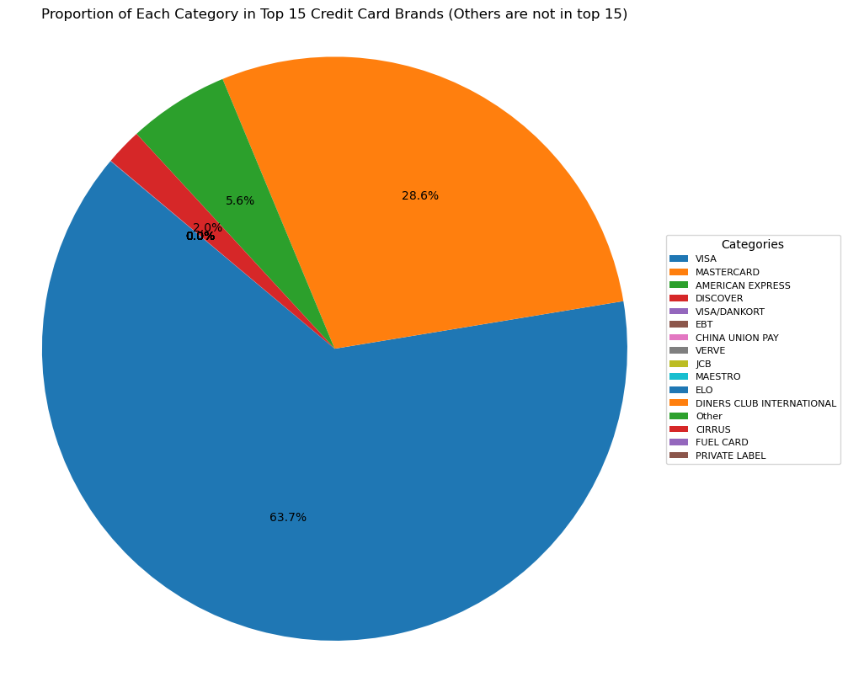
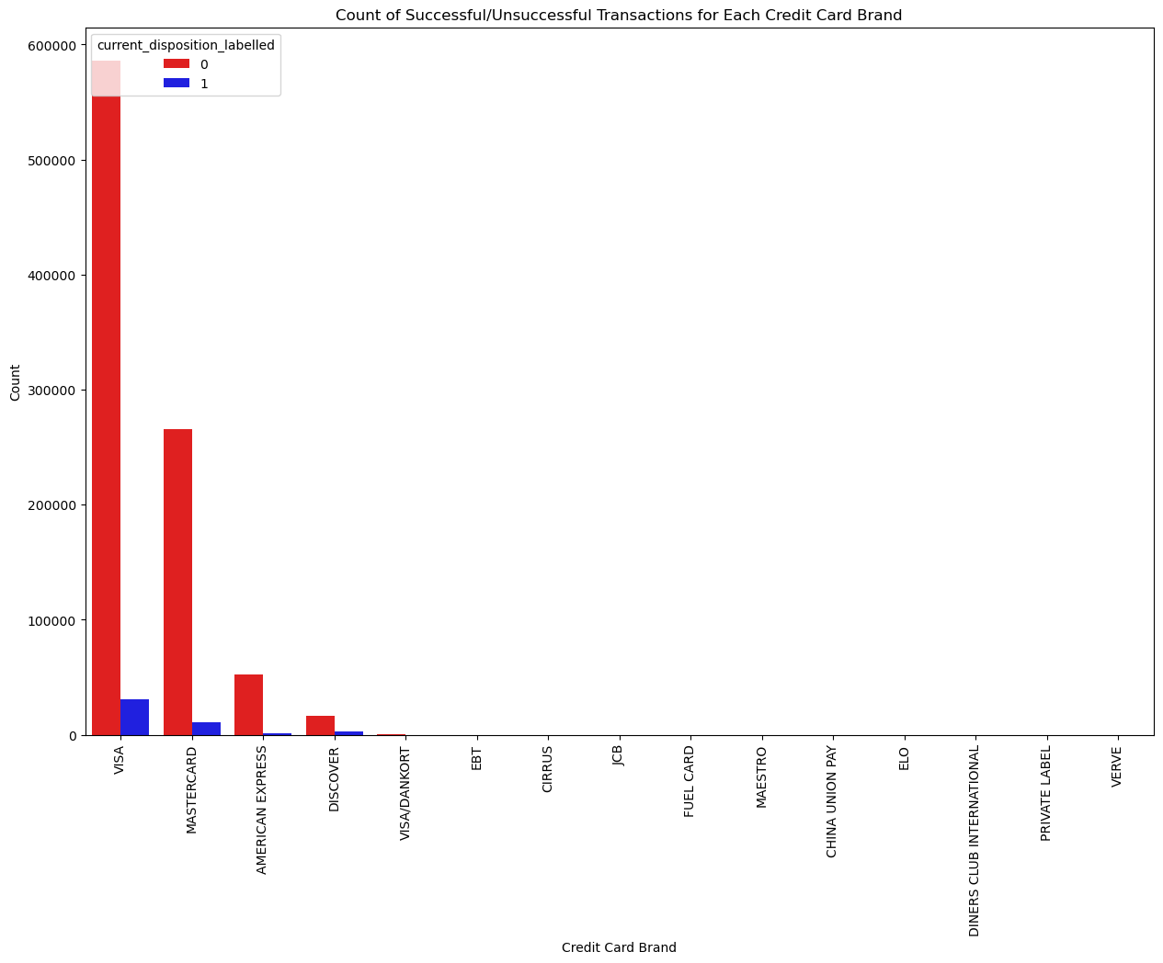
graphs and findings
‘credit_card_brand’

Slide 18
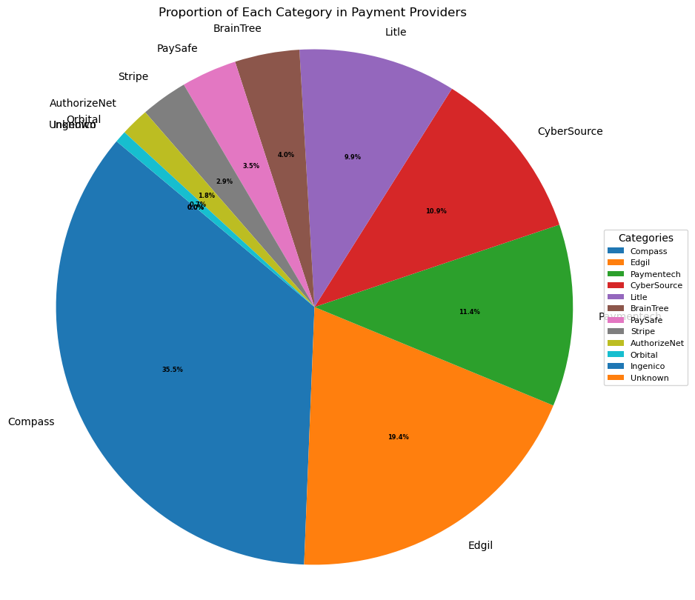
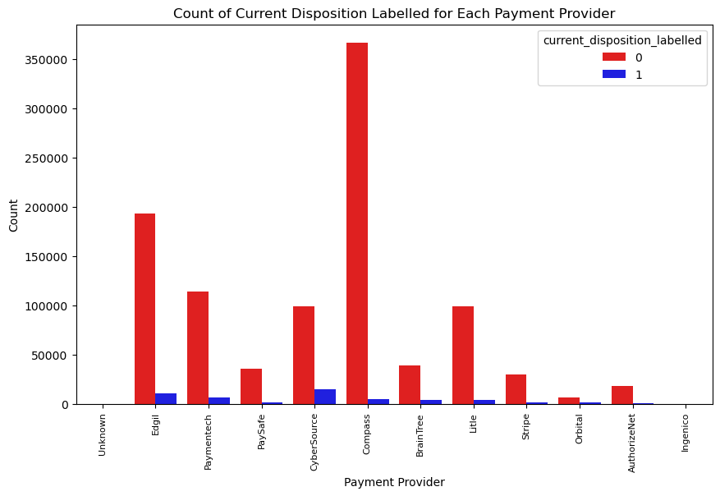
graphs and findings
payment provider

Slide 19
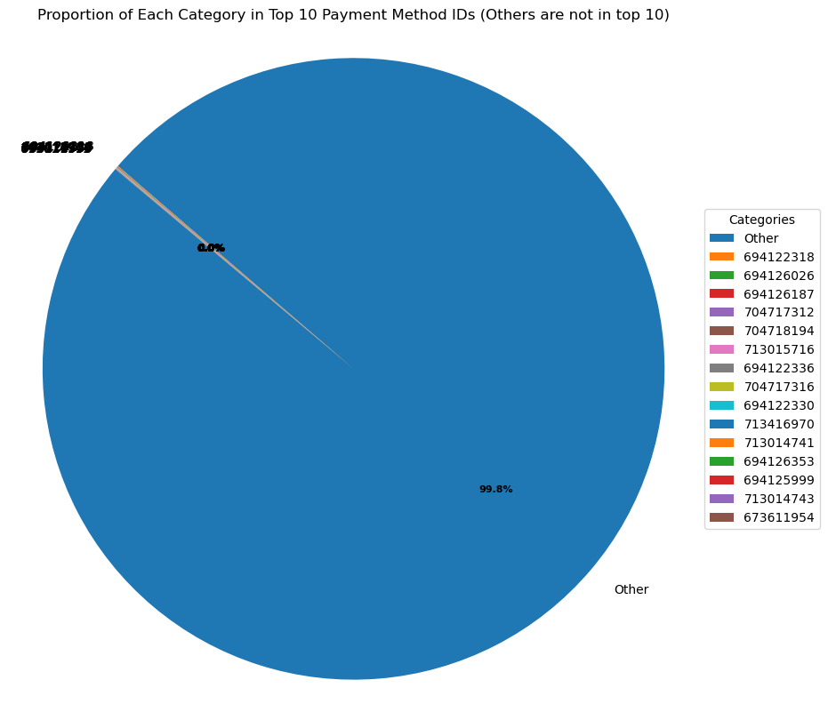
graphs and findings
'payment_method_id'

Slide 20
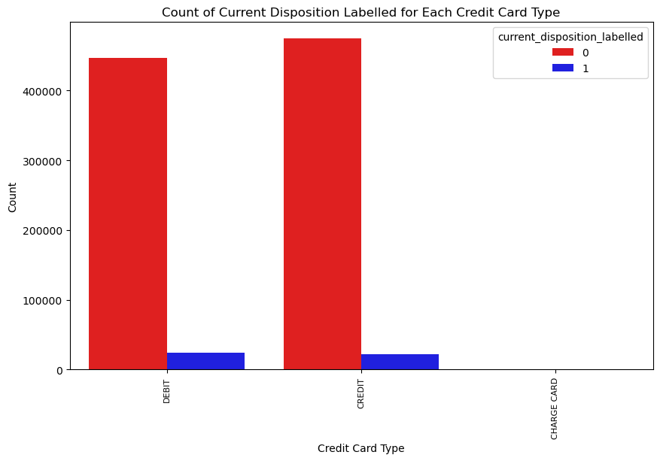
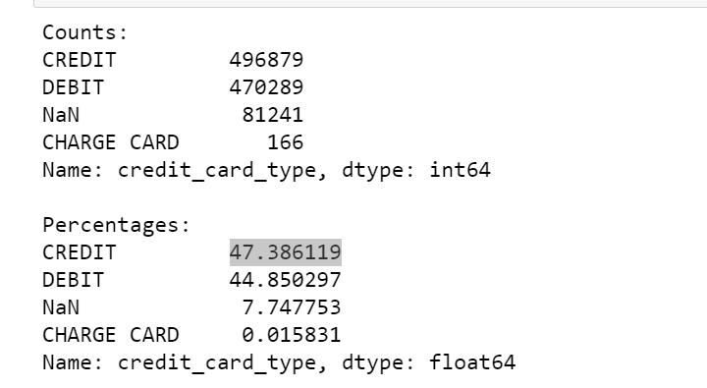
‘credit_card_type’

Slide 21
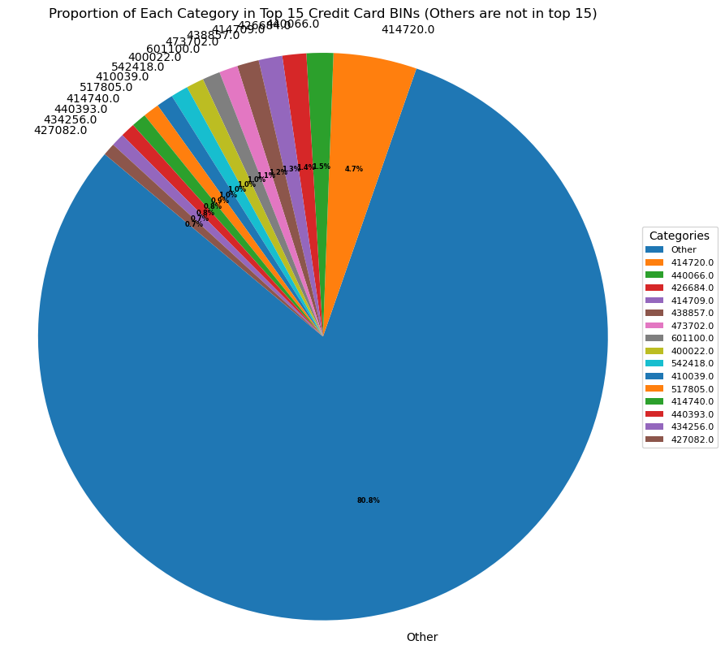
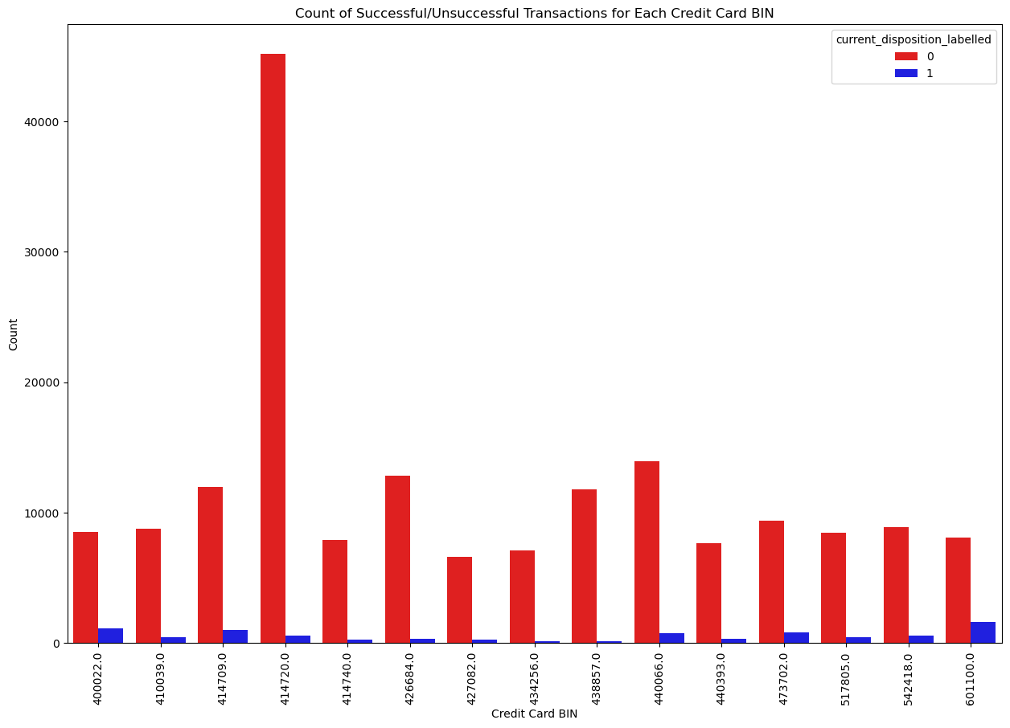
‘credit_card_bin’

Slide 22
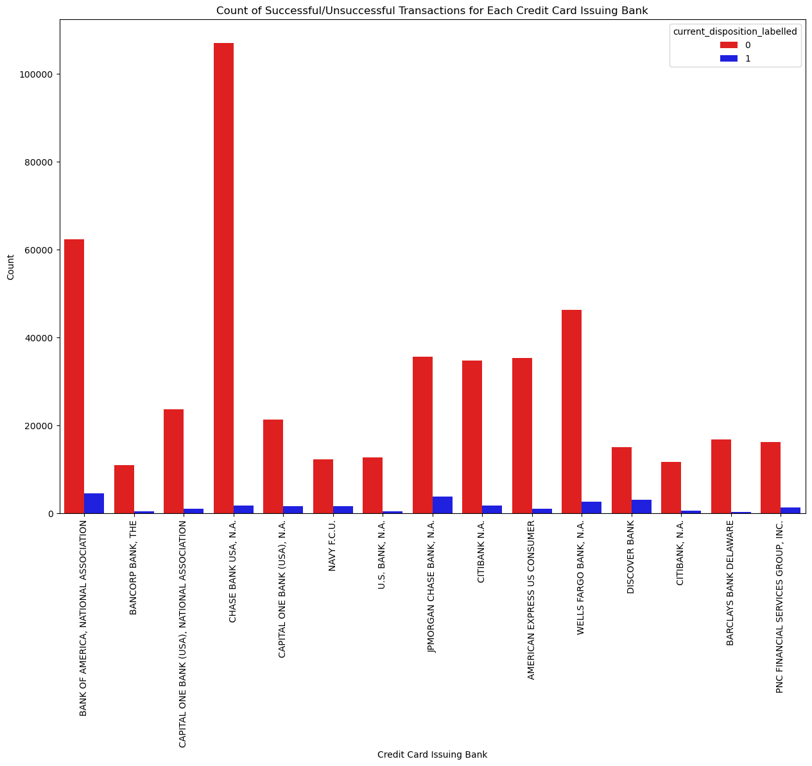
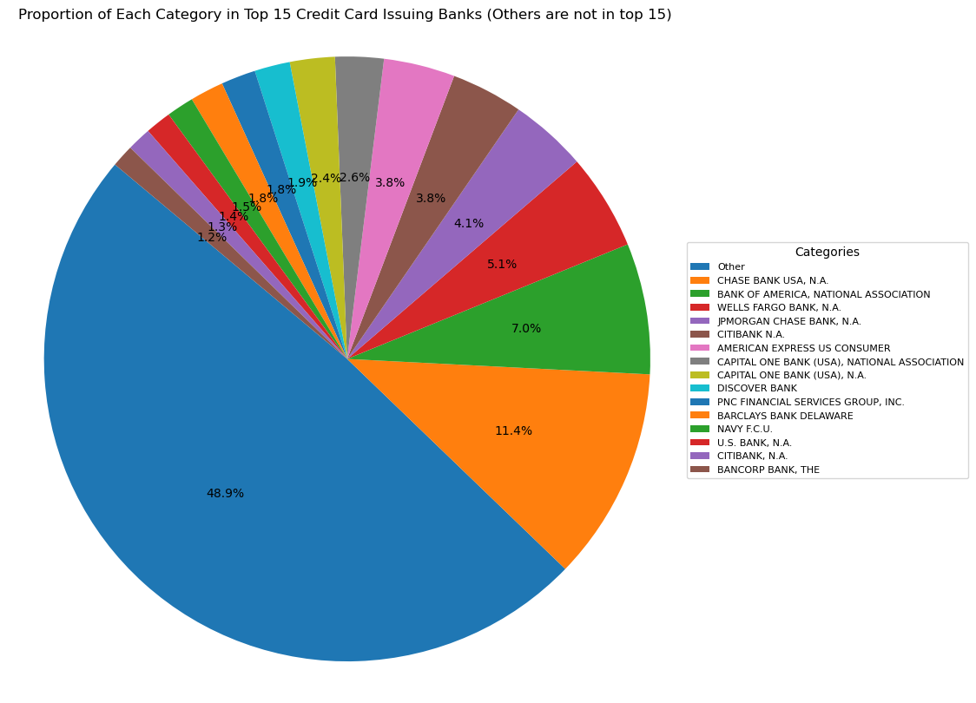
'credit_card_issuing_bank'

Slide 23
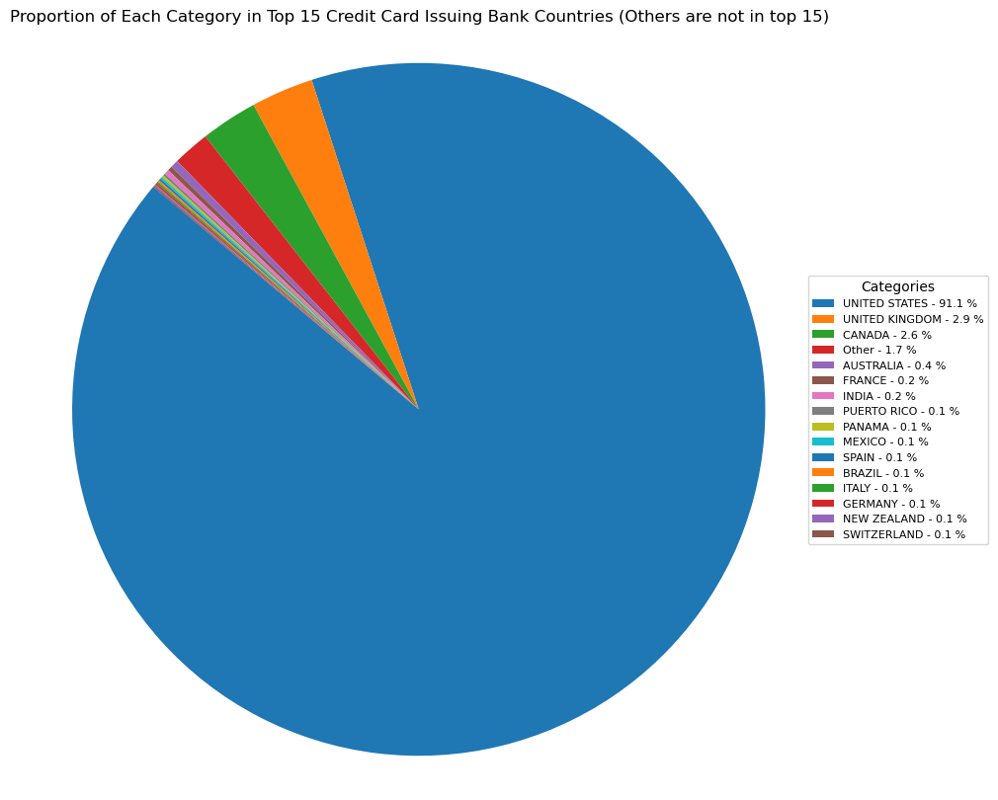
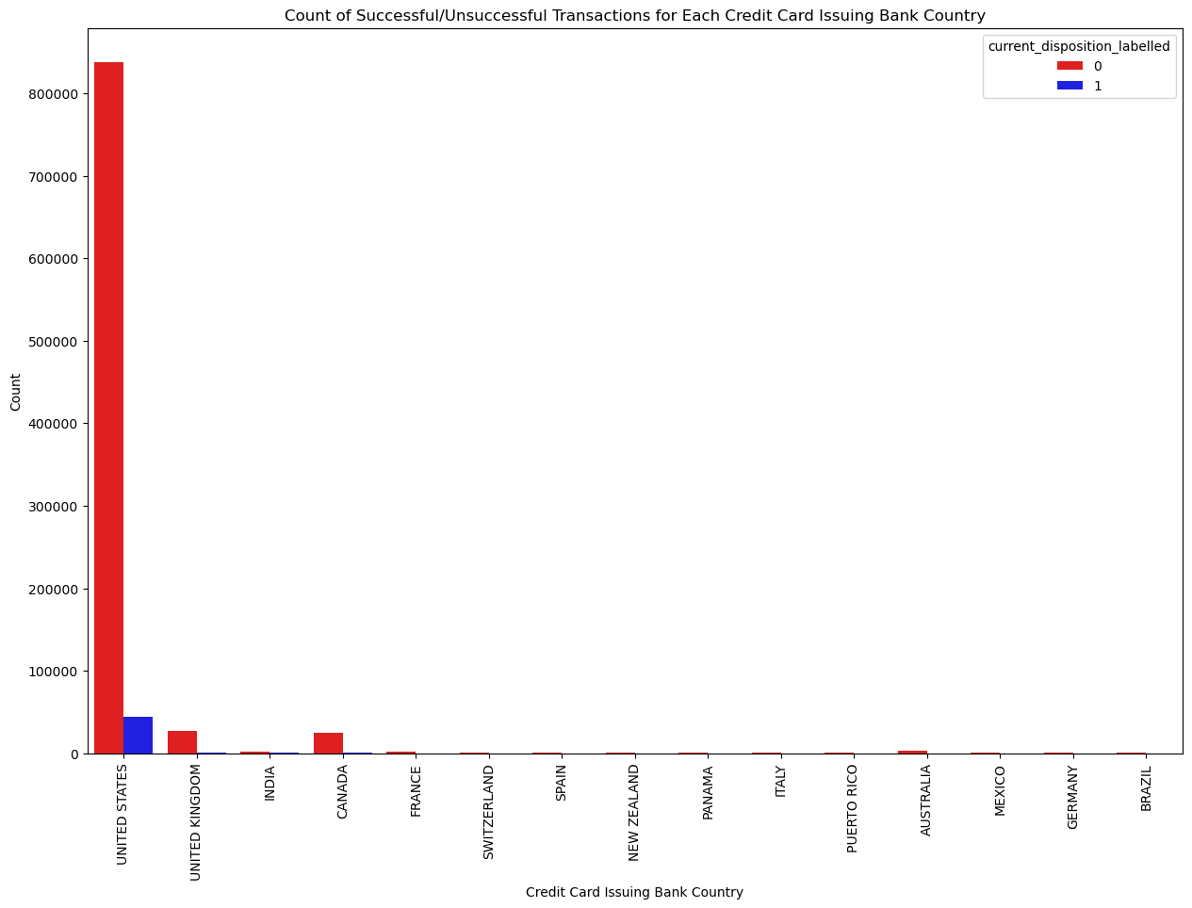
‘credit_card_issuing_bank_country’

Slide 24
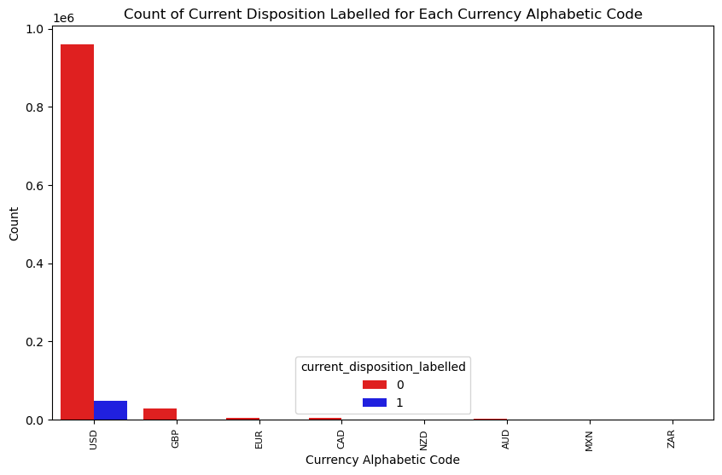
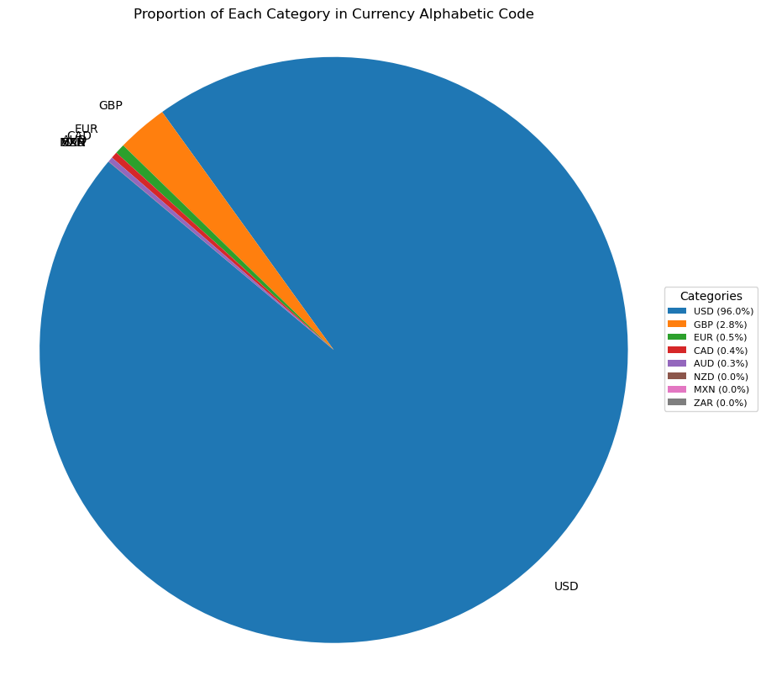
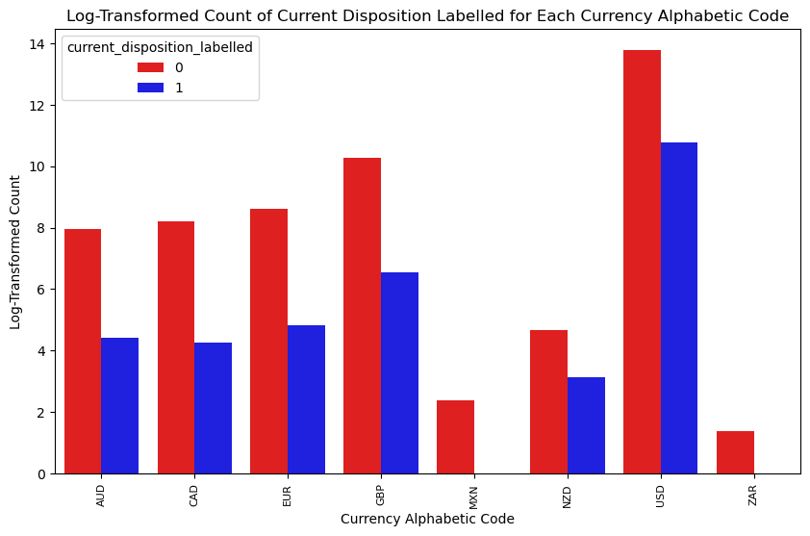
'currency_alphabetic_code'

Slide 25
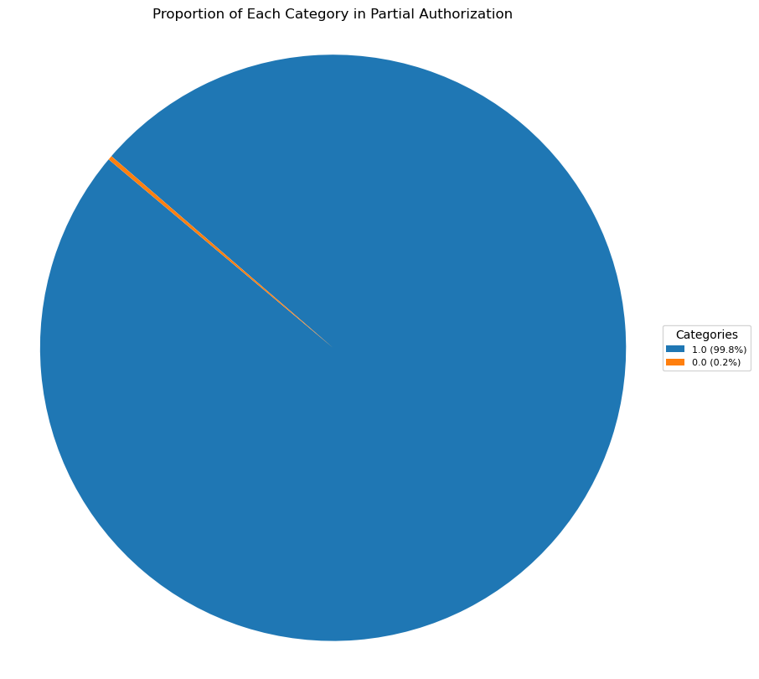
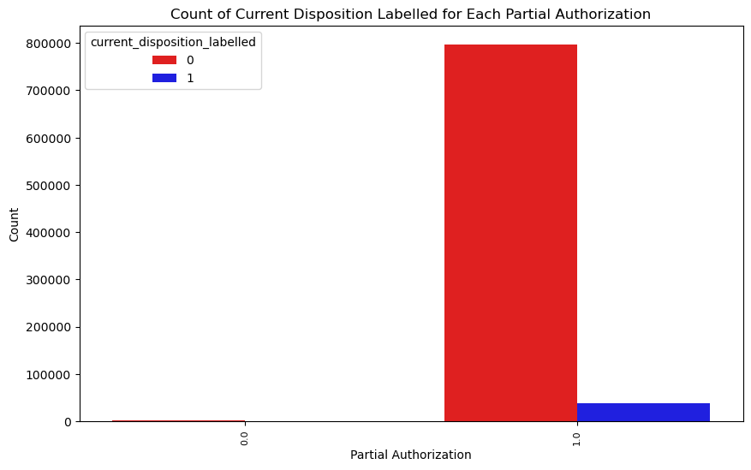
‘partial_auth’

Slide 26
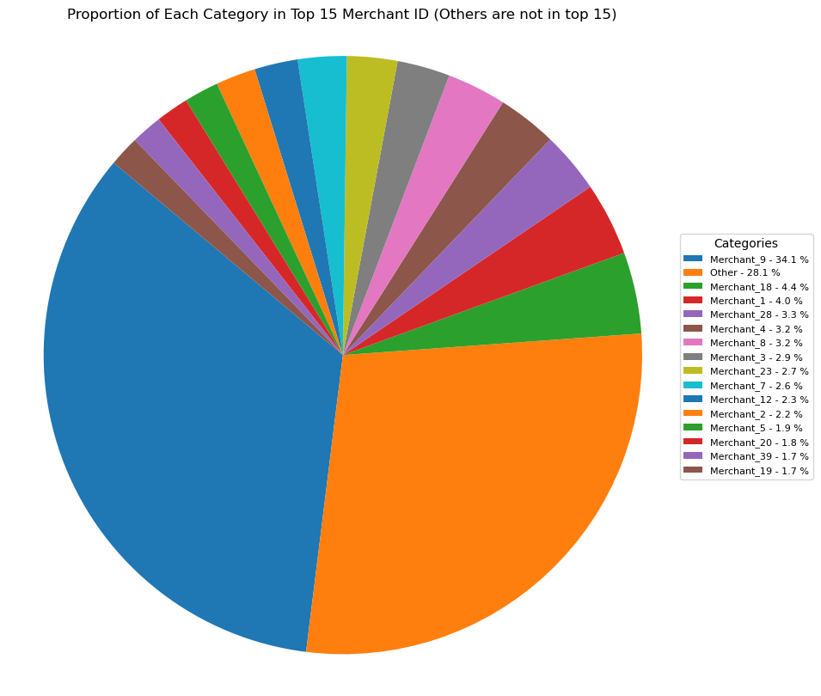
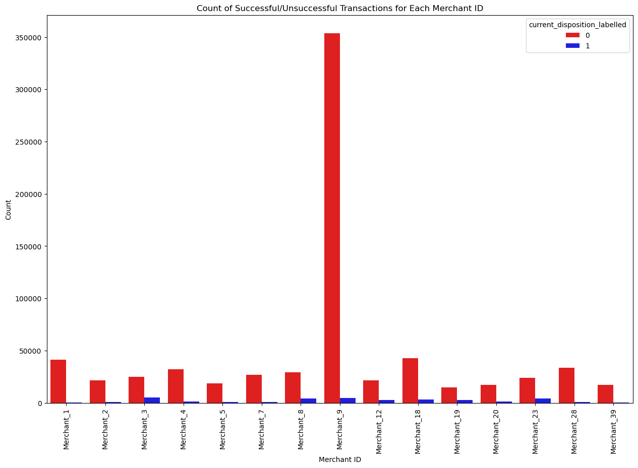
‘merchant_id’

Slide 27
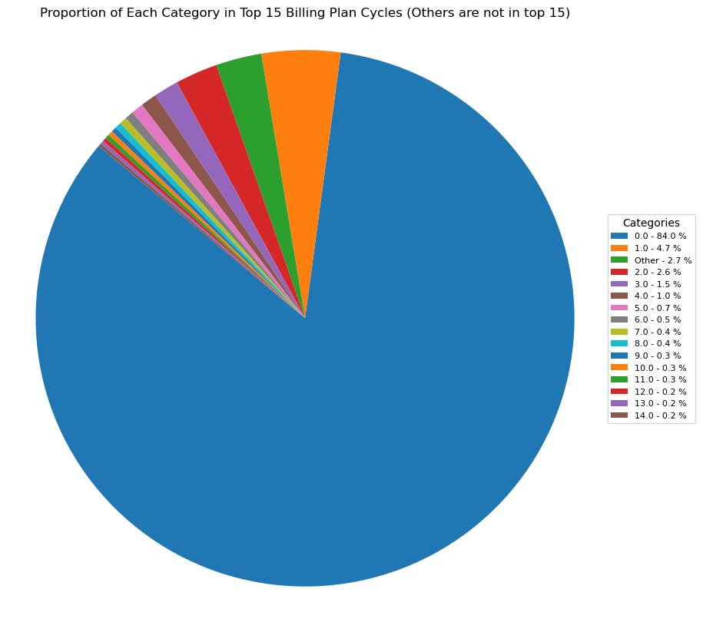
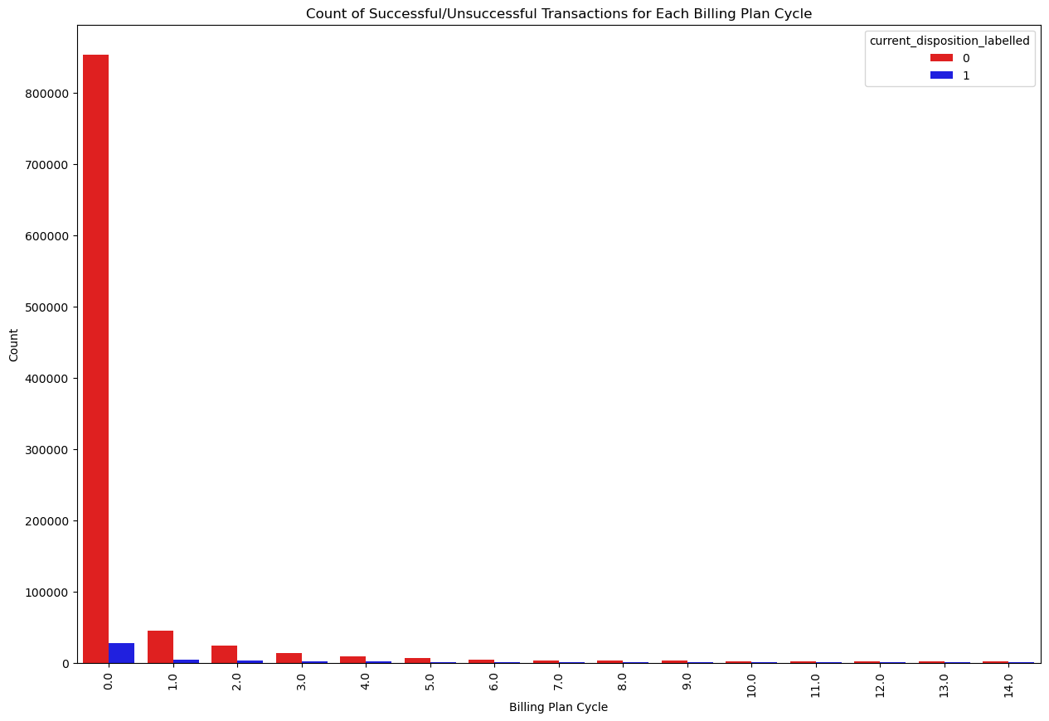
‘billing_plan_cycle’

Slide 28
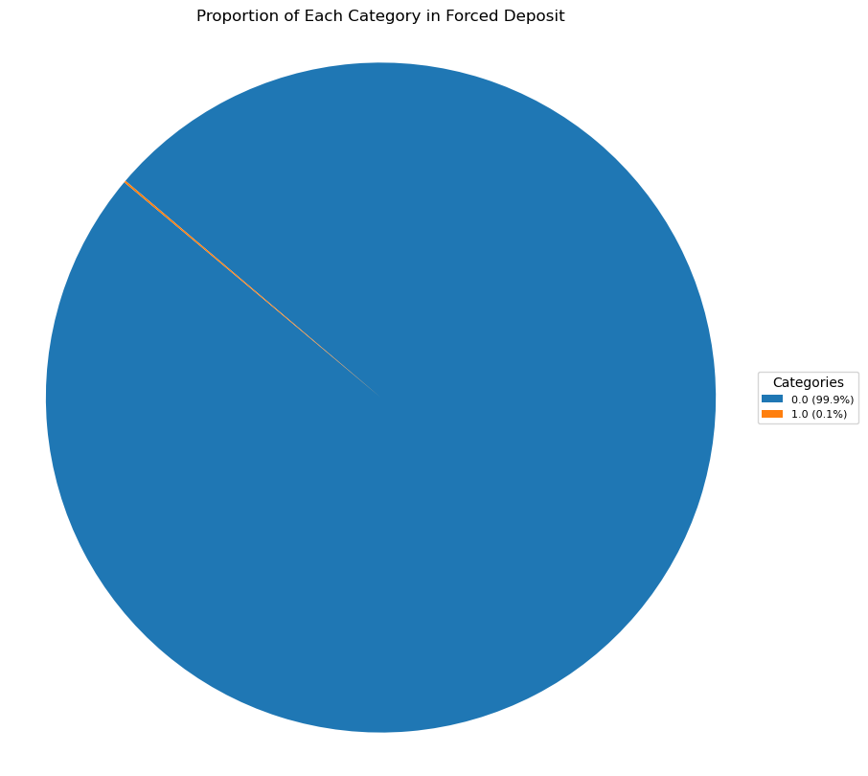
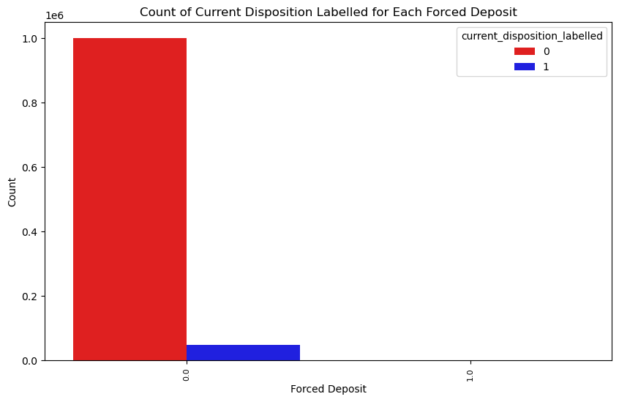
‘forced_deposit’

Slide 29
Identified Variables: Continuous Factors Correlation test
explanation | relative correlation level | Correlation number ( 1: -1) | Field
specific to the merchant (the way a merchant has set up their accounts with the payment provider) | Low | -0.017570688822195576 | 'division_number'
amount of a transaction (in original currency) | Very low | -0.000484 | 'Amount'
amount of a transaction if partial_auth allowed | Low + | 0.03316975778986724 | ‘partial_auth_amount’
frequency of a billing plan for a subscription | Some correlation | 0.09099822234823832 | ‘billing_plan_cycle’
exchange rate when transaction occurred | Low | 0.005541 | 'calc_merchant_day_exchange_rate'

Slide 30
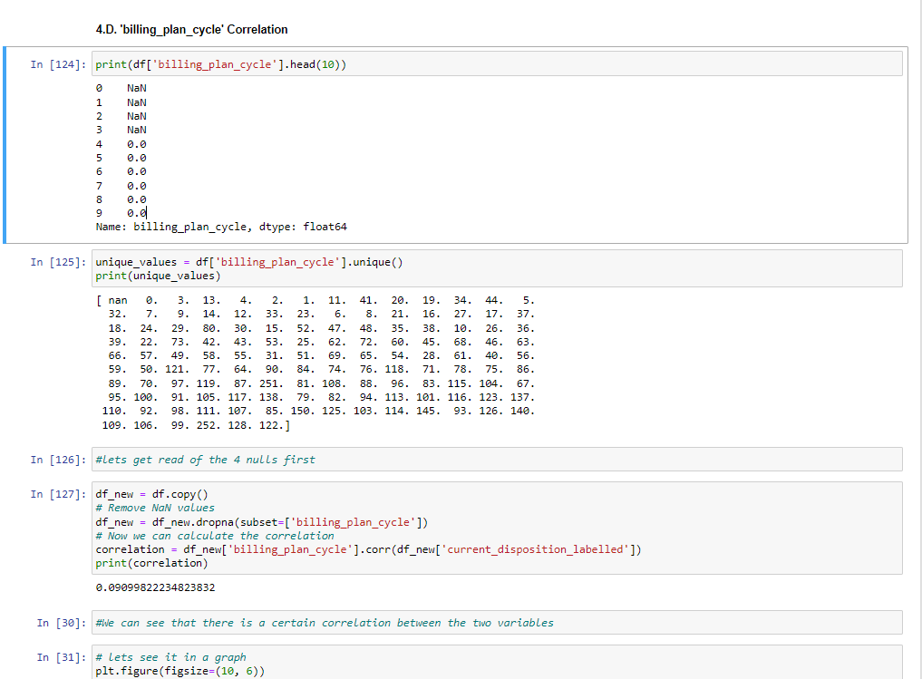
An example of a Python script - from the Gopiter notebook
billing_plan_cycle

Slide 31
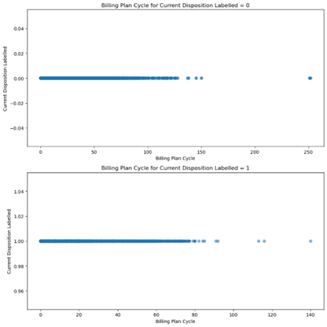
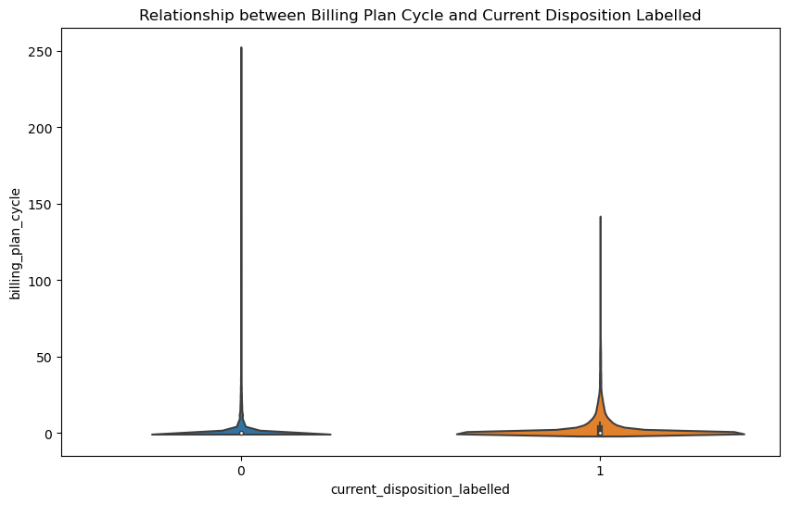
graphs and findings
billing_plan_cycle

Slide 32
significant understandings for further investigation:
CHASE BANK (USA)
‘414720’
partial_auth
Merchant_9
Compass
MASTERCARD,AMERICAN X, VISA
'credit_card_issuing_bank
‘Credit card bin’
Saturn is a gas giant and has several rings
Consider not giving a auth
merchant_id- merchant providing service to the customer
payment provider
*statistical significance tests are required

Slide 33
And now, for the most important part

Slide 34
graphs and findings
‘credit_card_brand’

Slide 35
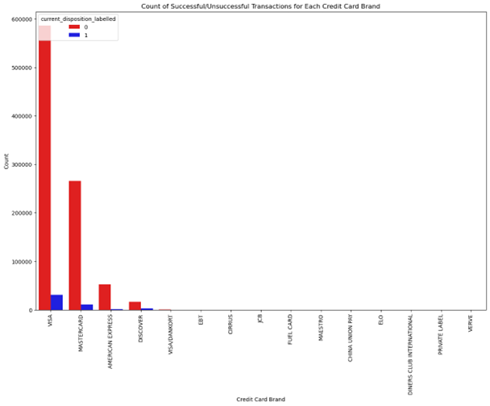
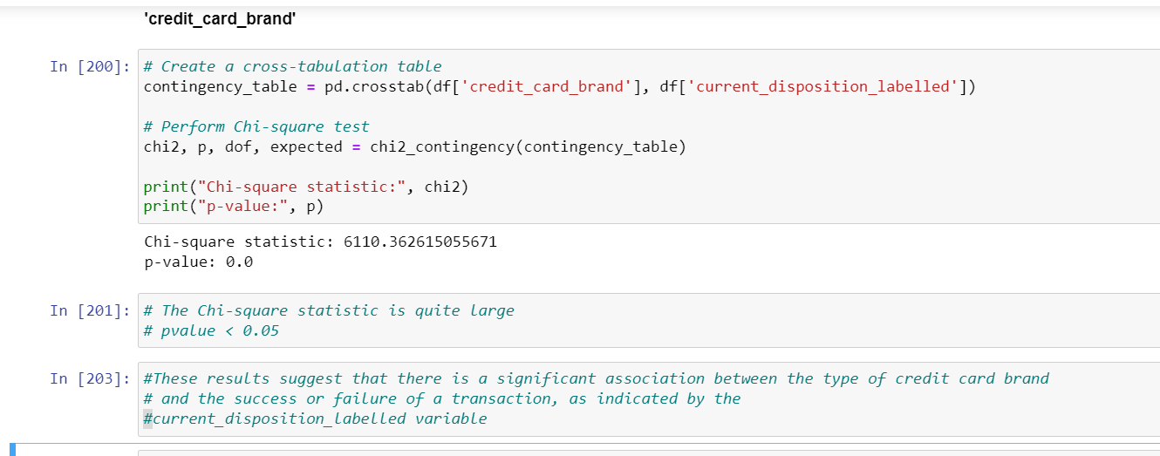
Statistical tests
Chi-Square Test of Independence. This test is commonly used for testing relationships between categorical variables. In this case, we are interested in whether the type of credit card (VISA, MASTERCARD, AMERICAN X) is associated with the outcome of the transaction
‘credit_card_brand’
statistical significance

Slide 36
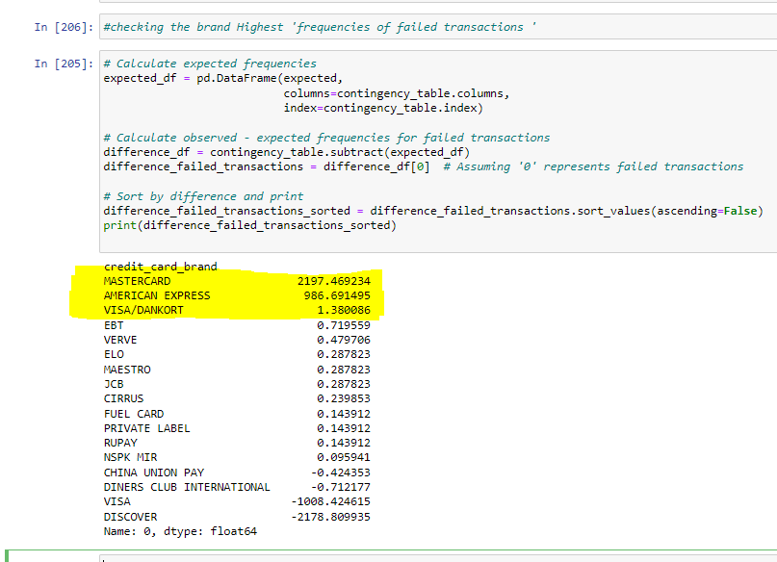
Statistical tests
frequencies of failed transactions
‘credit_card_brand’
statistical significance

Slide 37
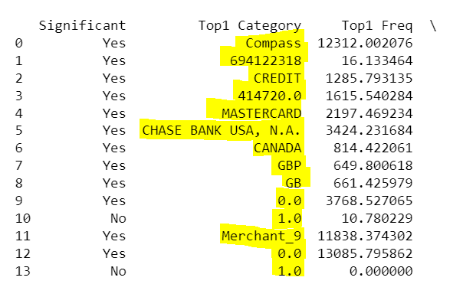
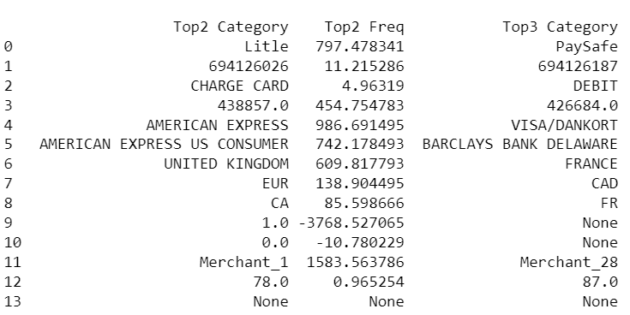
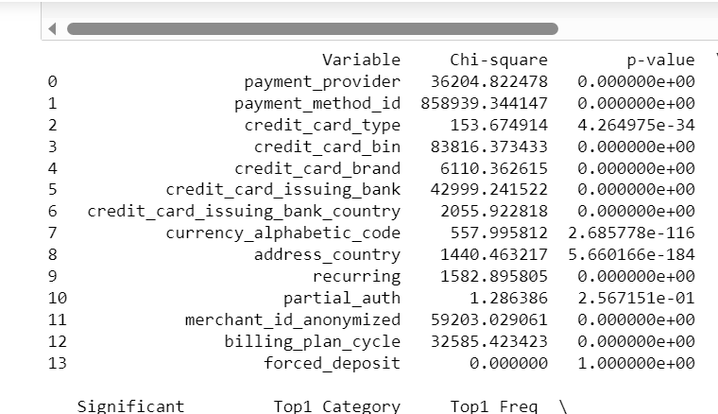
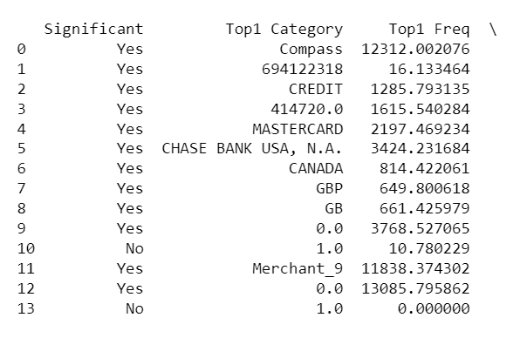
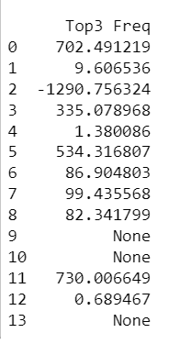
Statistical tests
summary table for all vars
statistical significance

Slide 38
06
What would be my next steps

Slide 39
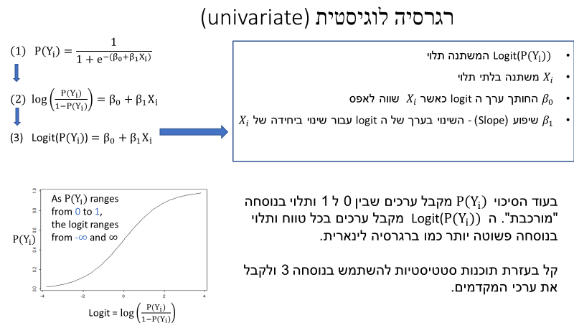
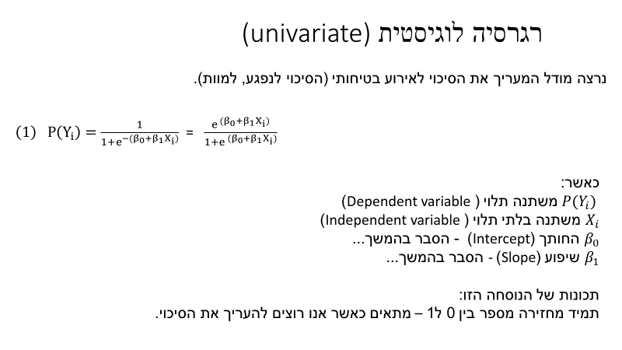

1.Logistic
Regression & Statistical tests
Where:
${ P(Y}_{i})$- Dependent variable
$X_{i}$- Independent variable – Factor variables
'current_disposition_labelled’
We will be studying the 'current_disposition_labelled' variable. It marks if a transaction worked on the first try. '1' means it did, '0' means it didn’t.
2.Creating aggregations and examining the effect of a billing cycle and the number of times in that cycle for the success of the billing transaction on the first try

Slide 40
06
Any other information I find relevant

Slide 41
"One of the main roles of a data analyst is to sort out the mess”
“Data is like a great river that has no end”

Slide 42
Thank You For Listening!

